Slide 1
Automated Code Editing With Search-Generate-Modify
Lai Hui Shan M5281022
Notes:
Hello everyone. Today, I’ll be presenting the paper ‘Automated Code Editing with Search-Generate-Modify’. This work introduces SARGAM, a new approach to improve automated code editing by combining search, generation, and modification.

Slide 2
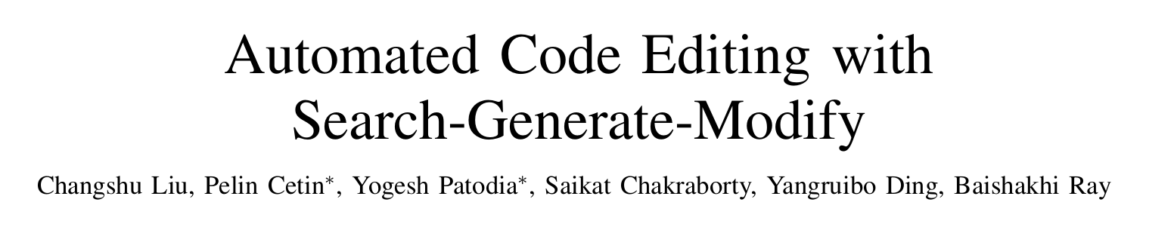
About
Author:
Changshu Liu; Pelin Cetin; Yogesh Patodia; Baishakhi Ray; Saikat Chakraborty; Yangruibo Ding
Url:
https://ieeexplore.ieee.org/document/10482873
Notes:
These are the authors and URL of the paper

Slide 3
Outline
Introduction
Background & Related Work
Proposed Approach
Experiments & Results
Conclusion & Future Work
Notes:
Here’s the outline of today I will talk.

Slide 4
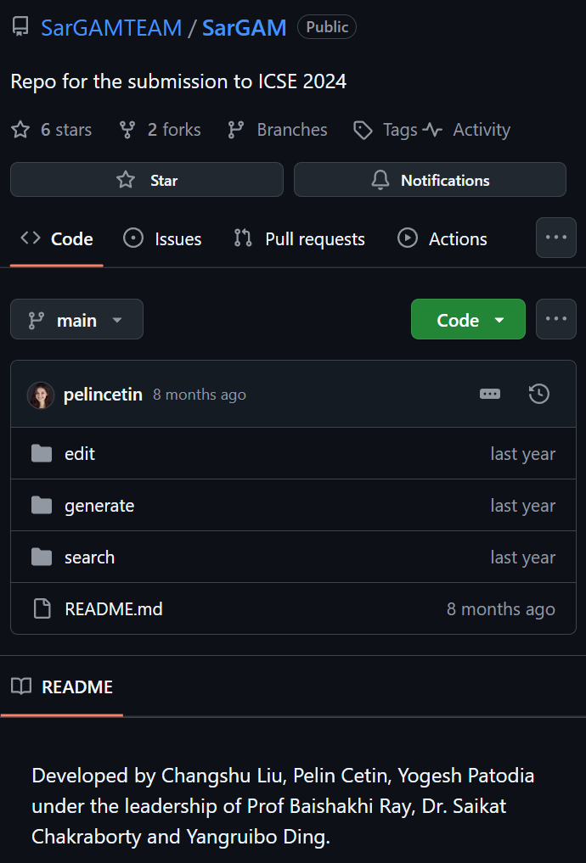
Introduction
Code editing challenges:
Developers frequently edit code to add features, fix bugs, or optimize performance, which can be complex and error-prone.
Motivation:
Existing automated tools have limitations in handling complex edits. There is potential to enhance accuracy by integrating search, generation, and modification steps.
Objective:
Introduce SARGAM, a framework that combines search, generate, and modify methods to better mimic developer behavior.
Notes:
Automated code editing is essential for adding features, fixing bugs, or improving code efficiency. However, this process is complex, and existing tools often fall short in handling complex edits. To address these challenges, this paper introduces SARGAM, which combines search, generate, and modify methods to enhance code editing accuracy. The goal is to make automated editing more similar to how real developers work.

Slide 5
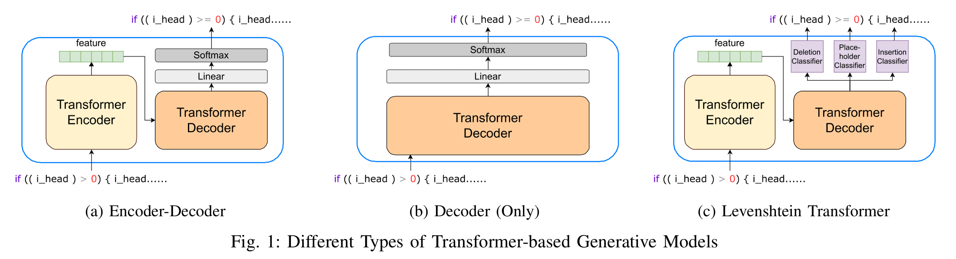
Background & Related Work
Search-Based Methods:
Retrieval of similar patches from existing databases, with limitations on adaptability to diverse contexts.
Generate-Based Methods:
LLMs like PLBART, CodeT5, Codex, which generate code but lack fine-grained editing capabilities.
Modify-Based Methods:
Code editing models like CoditT5 that allow token-level adjustments but struggle with major transformations.
Notes:
The three main methods in code editing today are Search, Generate, and Modify.
Search-based methods find similar code patches in existing database but are limited on adaptability to diverse scenarios.
Generate-based methods, LLMs like PLBART, CodeT5 and Codex, generate new code but can’t make specific edits.
Modify-based methods allow detailed token-level changes like CoditT5 model but struggle with larger edits.
SARGAM combines the best of all three methods for more effective code editing.

Slide 6
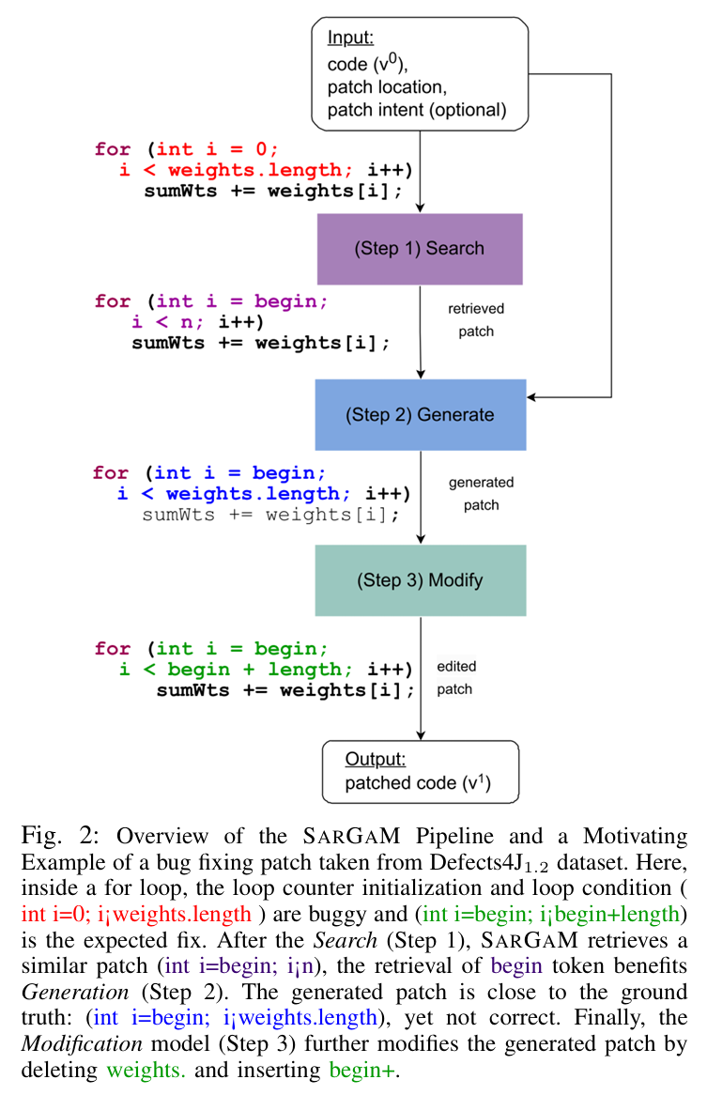
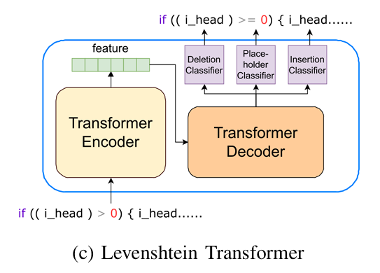
Proposed Approach - Overview of SARGAM
SARGAM Framework:
Search:
Finds related code patches to inform generation.
Generate:
Uses pre-trained models (like PLBART) to generate the initial patch.
Modify:
Applies fine-grained modifications using a Levenshtein Transformer.
Notes:
SARGAM uses three steps:
Search: Finds similar code patches to guide generation.
Generate: Uses models like PLBART to create an initial code patch.
Modify: Refines the generated patch using the Levenshtein Transformer for fine-grained changes.
The diagram here shows how these steps work together in the SARGAM framework to mimic developer actions in real code editing.

Slide 7
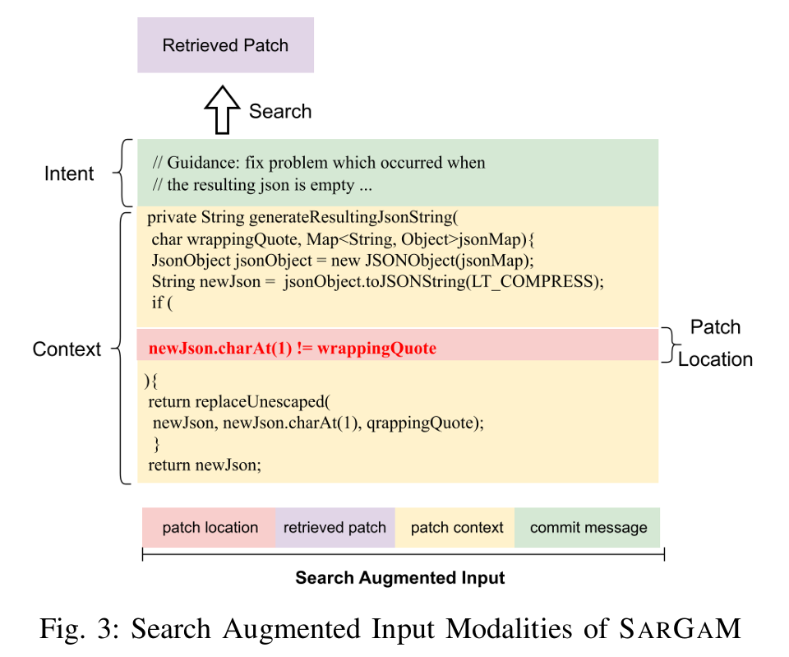
Proposed Approach - Details of Each Step
Search:
Searches for patches in a patch database using edit context and location.
Generate:
Creates a rough draft of the code patch based on search results.
Modify:
Refines the generated patch with token-level additions or deletions for accuracy.
Notes:
Each step of SARGAM is important:
Search retrieves patches from a database based on context and path location.
Generate produces a rough draft of the code path based on the search results.
Modify fine-tunes the draft with small changes, like adding or removing tokens, to make it accurate.
These three steps allow SARGAM to handle complex editing tasks that other tools might miss.

Slide 8
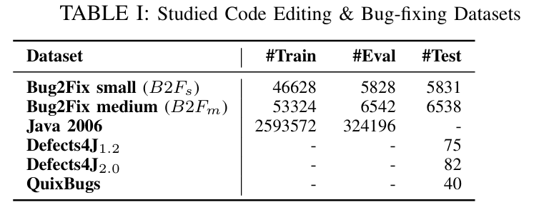
Experimental Design
Datasets:
Bug2Fix, Defects4J, QuixBugs.
Evaluation Metrics:
Top-1 and Top-5 accuracy for code editing; patch correctness for bug-fixing tasks.
Baselines:
Compared SARGAM with PLBART, CoditT5, NatGen, and other baseline models.
Notes:
SARGAM was tested on datasets like Bug2Fix, Defects4J and QuixBugs. The evaluation focused on accuracy—Top-1 and Top-5 for code editing and correctness in bug-fixing tasks. SARGAM was compared to baseline models, including PLBART, CoditT5, NatGen, and other baseline models, to show how it performs relative to other existing methods.

Slide 9
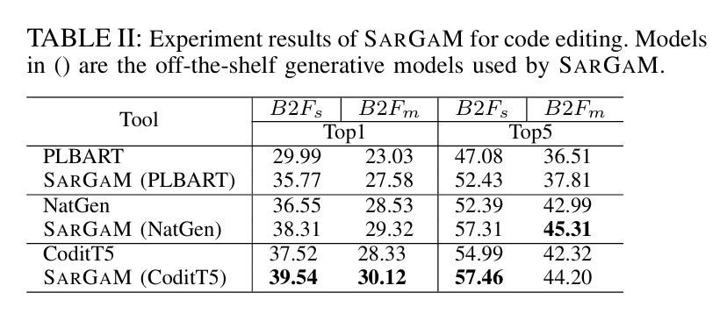
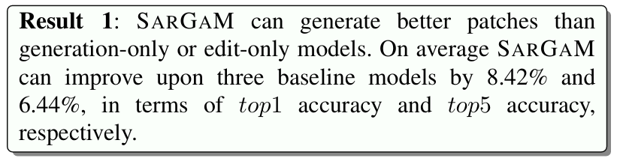
Results - Code Editing
Results Summary:
SARGAM improved accuracy over baselines in both Top-1 and Top-5 settings.
Performance Comparison:
SARGAM improved upon PLBART, CoditT5, and NatGen by 15.61%, 3.80% and 5.85% in terms of Top-1 accuracy.
Notes:
In code editing tasks, SARGAM showed higher accuracy than the baseline models. It improved Top-1 and Top-5 accuracy by an average of 8.42% and 6.44% over other models, which means SARGAM was able to produce correct code patches more often. The table here compares accuracy between SARGAM and other models, clearly showing SARGAM’s advantage.

Slide 10
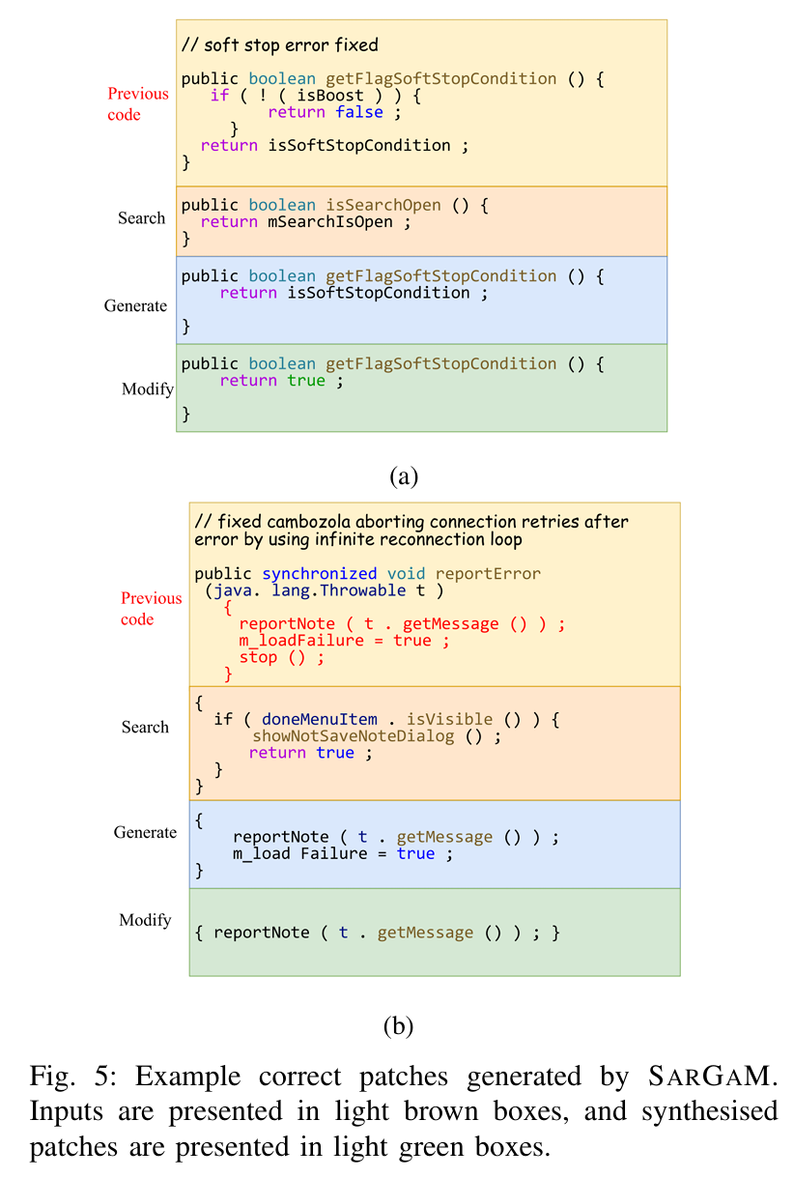
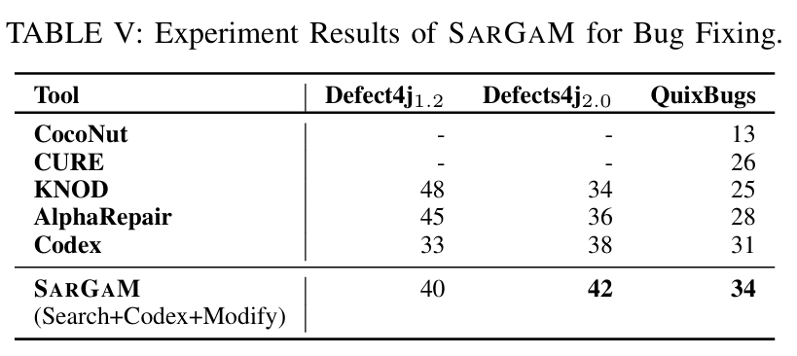
Results - Program Repair
Dataset:
Defects4J and QuixBugs.
Accuracy:
SARGAM achieved state-of-the-art results, outperforming previous models by fixing additional bugs.
Notes:
For bug-fixing tasks, SARGAM performed very well. Using datasets like Defects4J and QuixBugs, SARGAM achieved state-of-the-art results, fixed more bugs than previous models, proving effective in real-world error correction. These examples show how SARGAM successfully handled complex bug fixes, even in cases where other models struggled.

Slide 11
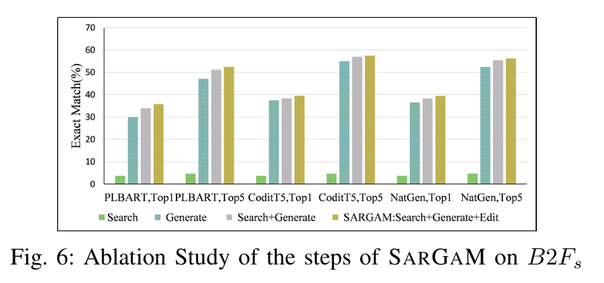
Ablation Study
Effect of Each Component:
Search, Generate, and Modify components all contribute to SARGAM's success.
Study Findings:
Removing any component led to a decrease in overall performance.
Notes:
In the ablation study, each component—Search, Generate, and Modify—was tested individually. The Results showed that removing any of these steps reduced SARGAM’s performance. This confirms that each component is necessary, as each one plays a unique role in improving the overall code editing accuracy.

Slide 12
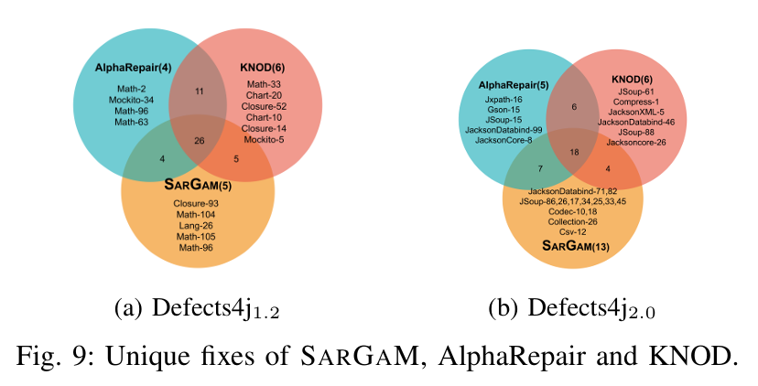
Conclusion & Future Work
Summary:
SARGAM significantly improves code editing and bug-fixing tasks by combining search, generation, and modification.
Future Directions:
Integrate more datasets, enhance the modification model, explore different programming languages.
Notes:
To summarize, SARGAM significantly improves code editing and bug-fixing by combining search, generation, and modification.
For future work, the authors suggest testing SARGAM on additional datasets, refining the modification step, and possibly adapting it for different programming languages.
This could further expand SARGAM’s usefulness in automated code editing.

Slide 13
Thank You!
Presentation Duration:
10 minutes
Approximate Slide Count:
13 slides
Notes:
Thank you for your attention! That’s the end of my presentation

